Slide 1
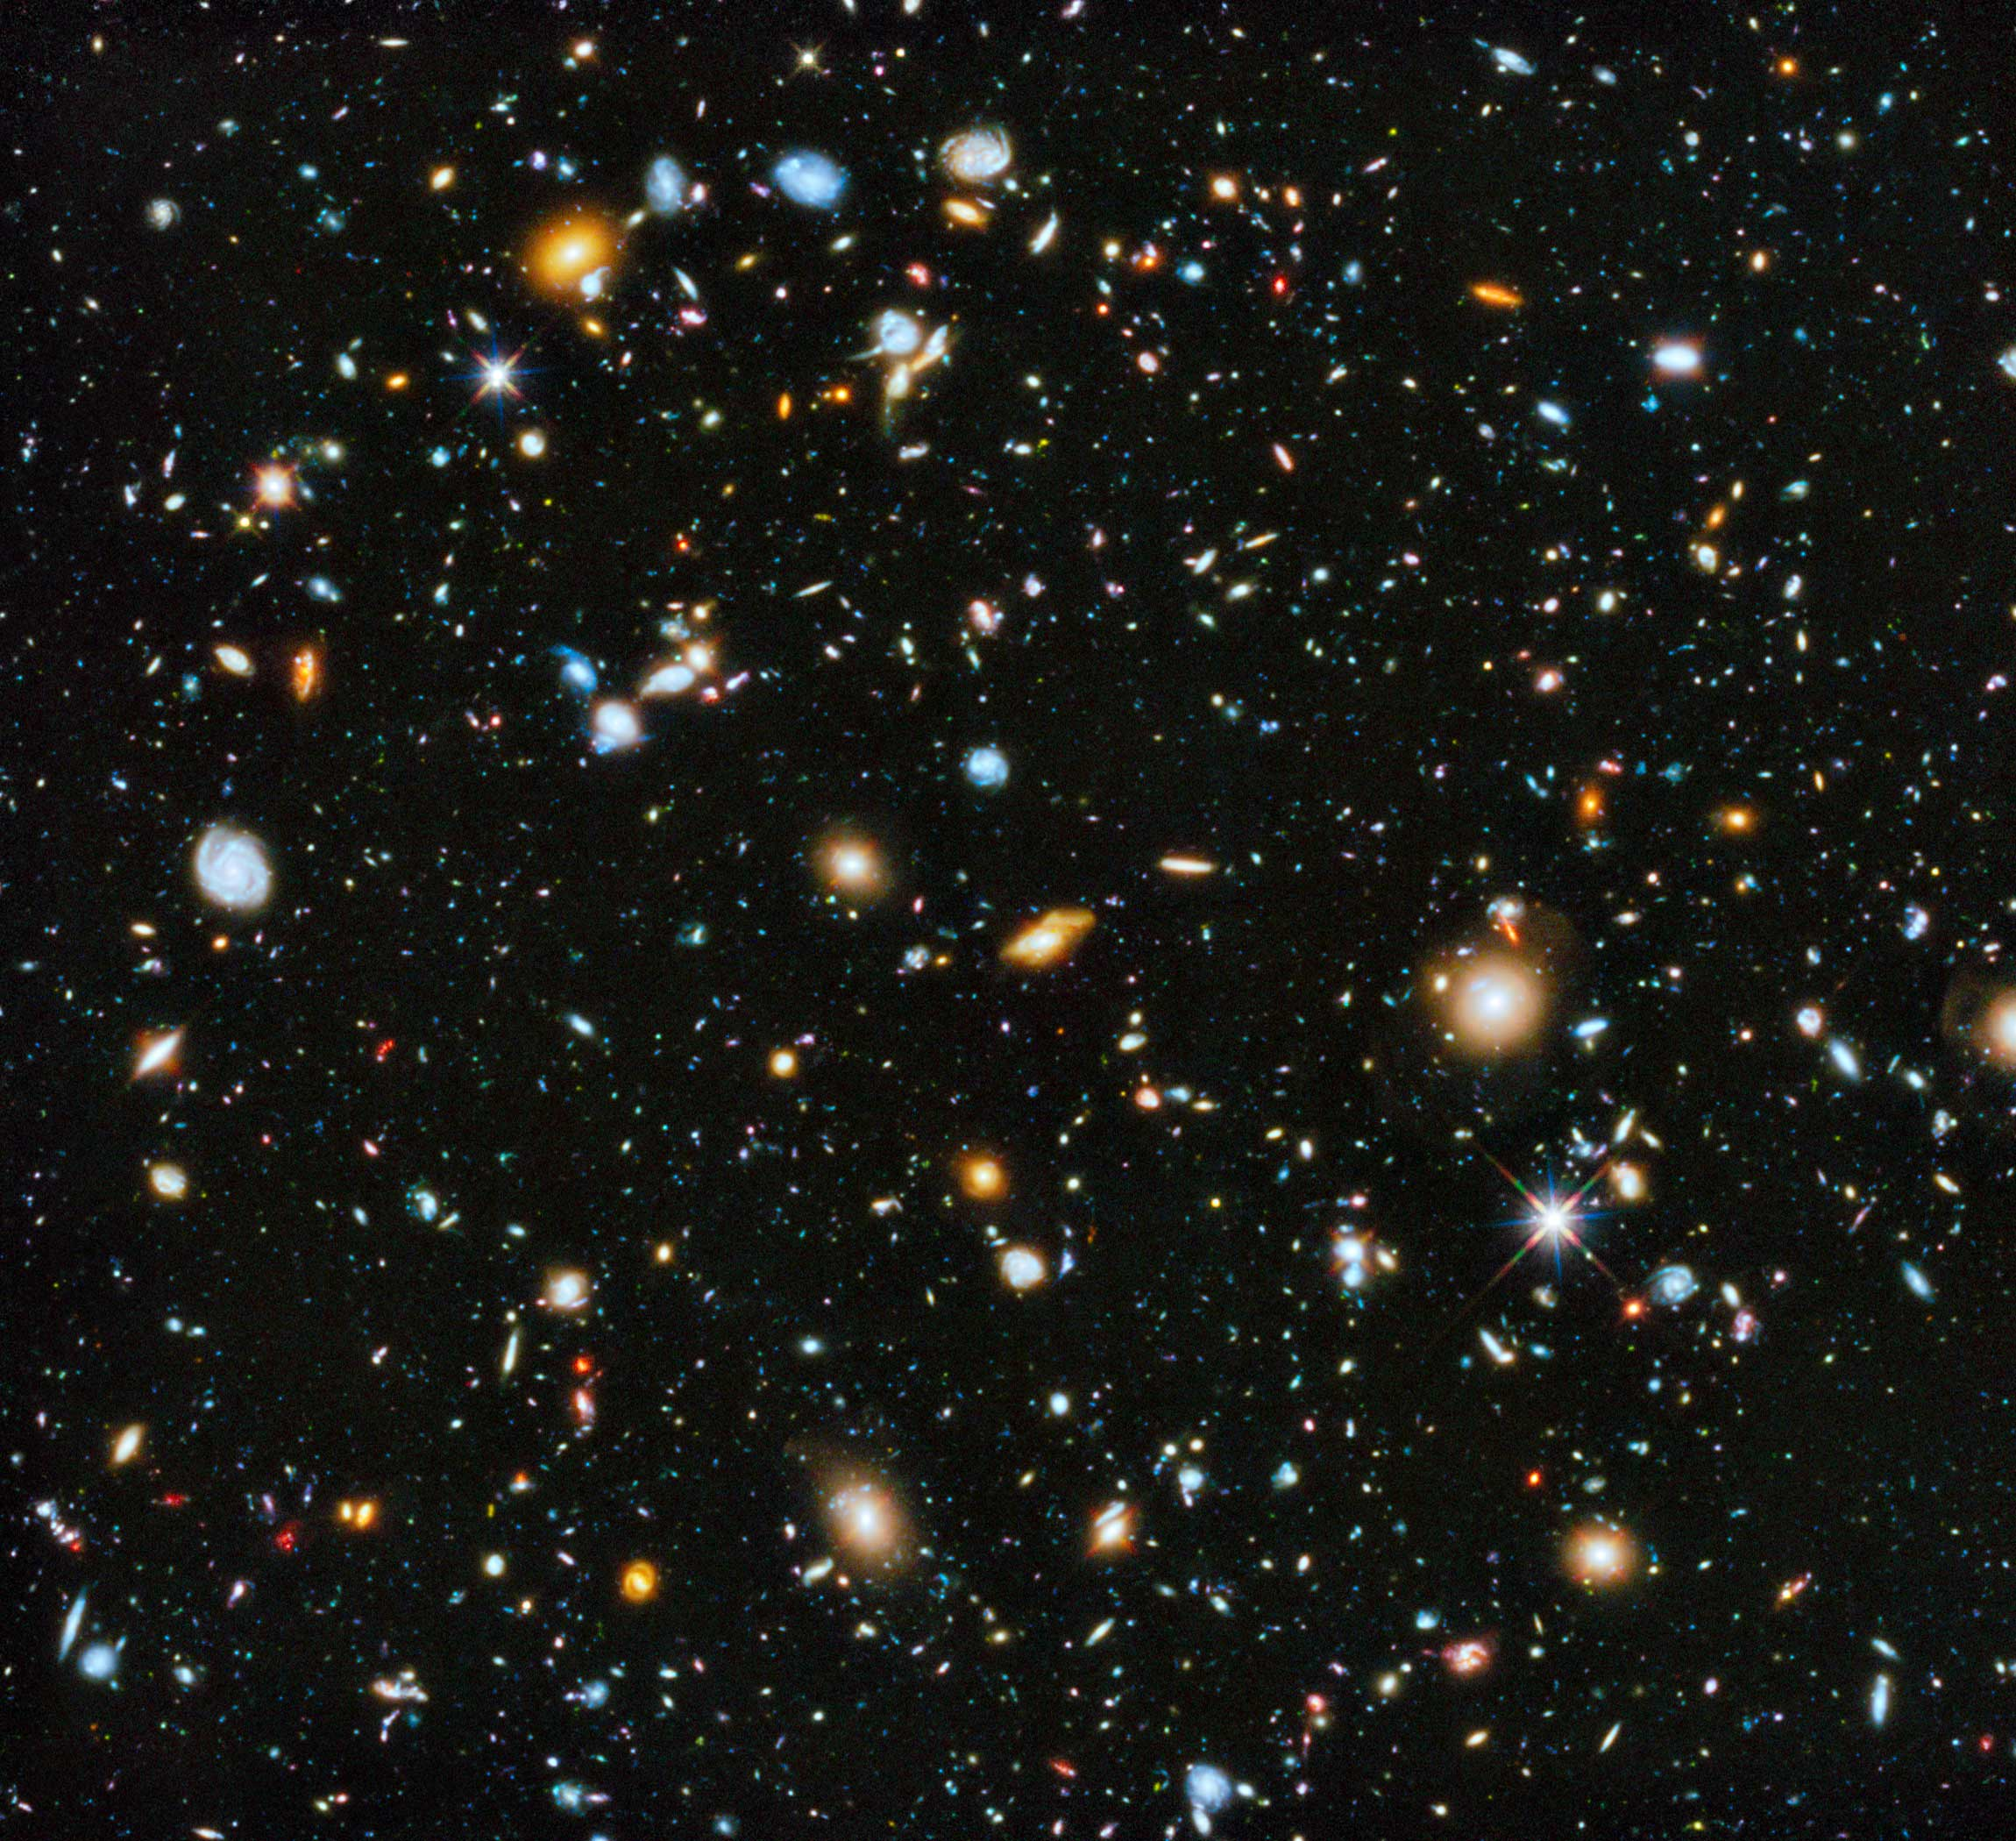
SDSS Classification
Diego McDonald

Slide 2
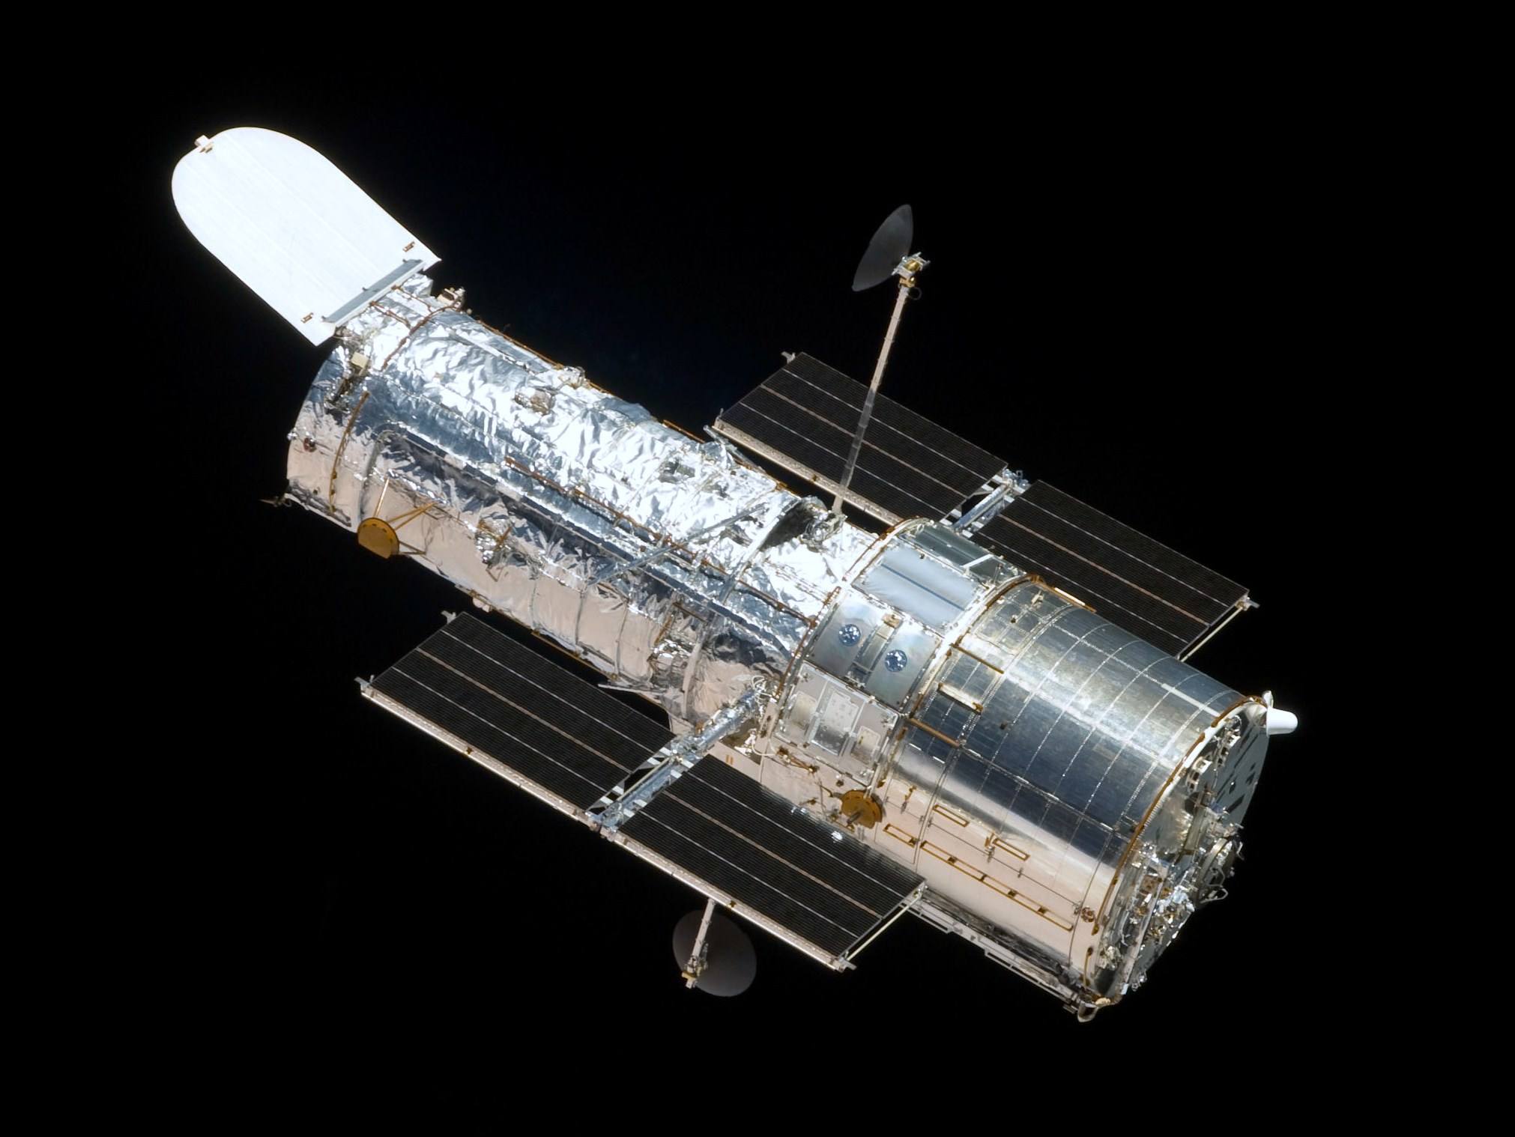
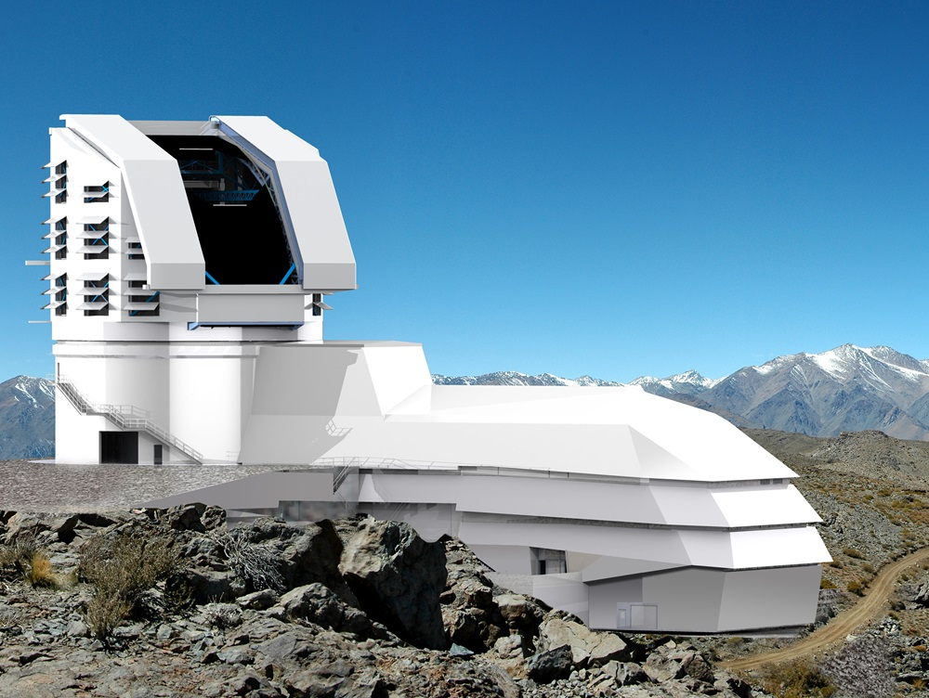
Problem Statement
Notes:
ASTRONOMY BECOMING A DATA SCIENCE DOMINATED FIELD
Changes from Telescopes seeing very dim to seeing very wide.
Left – Hubble Space Telescope
18GB/week average
LSST (https://astronomy.com/news/2017/12/the-lsst-and-big-data-science) and (https://www.lsst.org/about)
20TB processed and stored each night
Planned to deliver over 500 PetaBytes

Slide 3
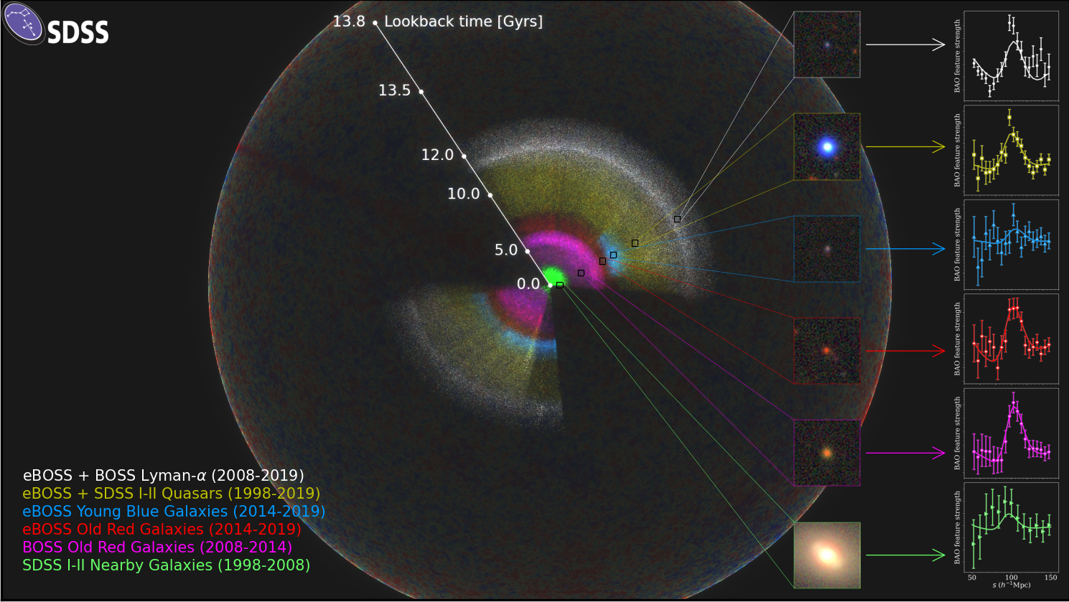
Objective
Notes:
SDSS
Lots to look at
Most important features
Each point is an observation
Each color is how far back in time we are looking
The further back we look, we are able to see more “creation” → younger galaxies
Data
230 million objects
>270 TB

Slide 4
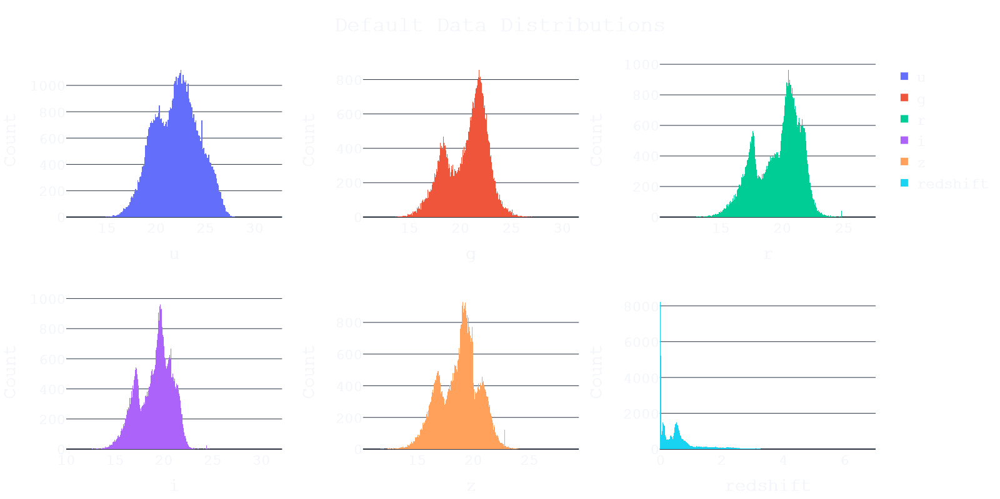
Datasets – Photometry
Notes:
Displayed:
Distributions of selected features PRIOR TO TRANSFORMATION
U G R I Z → measures brightness in a specific wavelength
Redshift → how much wavelength has shifted from first emission to when we detected it
Correlates with distance away from us and age of object.
Multi-Modal distributions → evidence of clustering

Slide 5
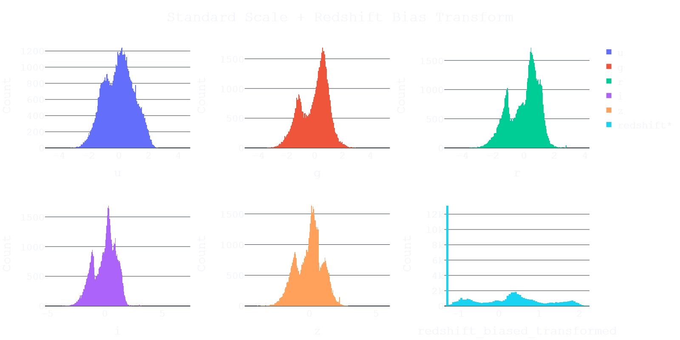

Datasets – Photometry
𝓏 $= \frac{λ_{obs}}{λ_{rest}}−1$
Notes:
Displayed:
Wavebands:
Easy
Standard Scaler and was done
Redshift
Not so easy
Allows for negative numbers
Cant take log of negative number to help with skewness
Equation has an implicit – 1,
Bias = +1
Can now transform

Slide 6
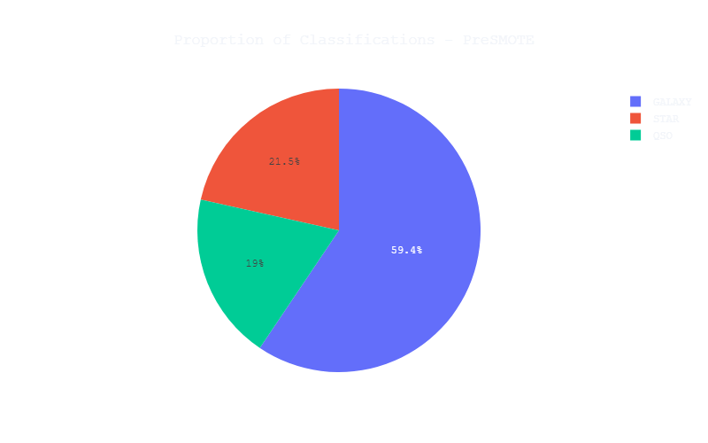
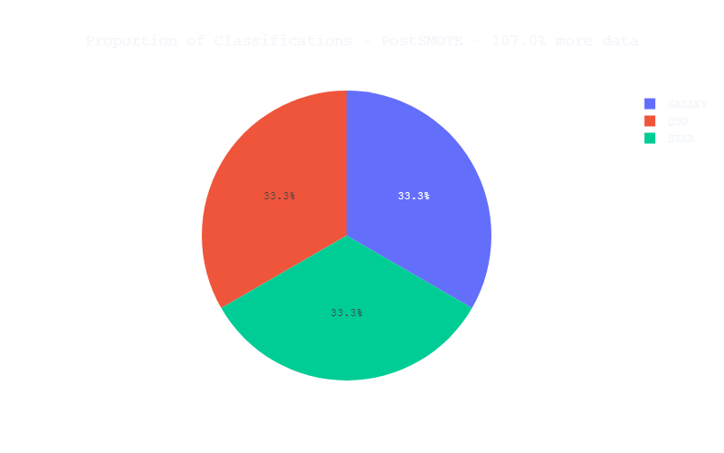
Datasets – Labels
Notes:
Working with a subset
~100,000 records → 100,000 objects
Classification proportions
~60% galaxies
~20% each for star and QSO respectively

Slide 7
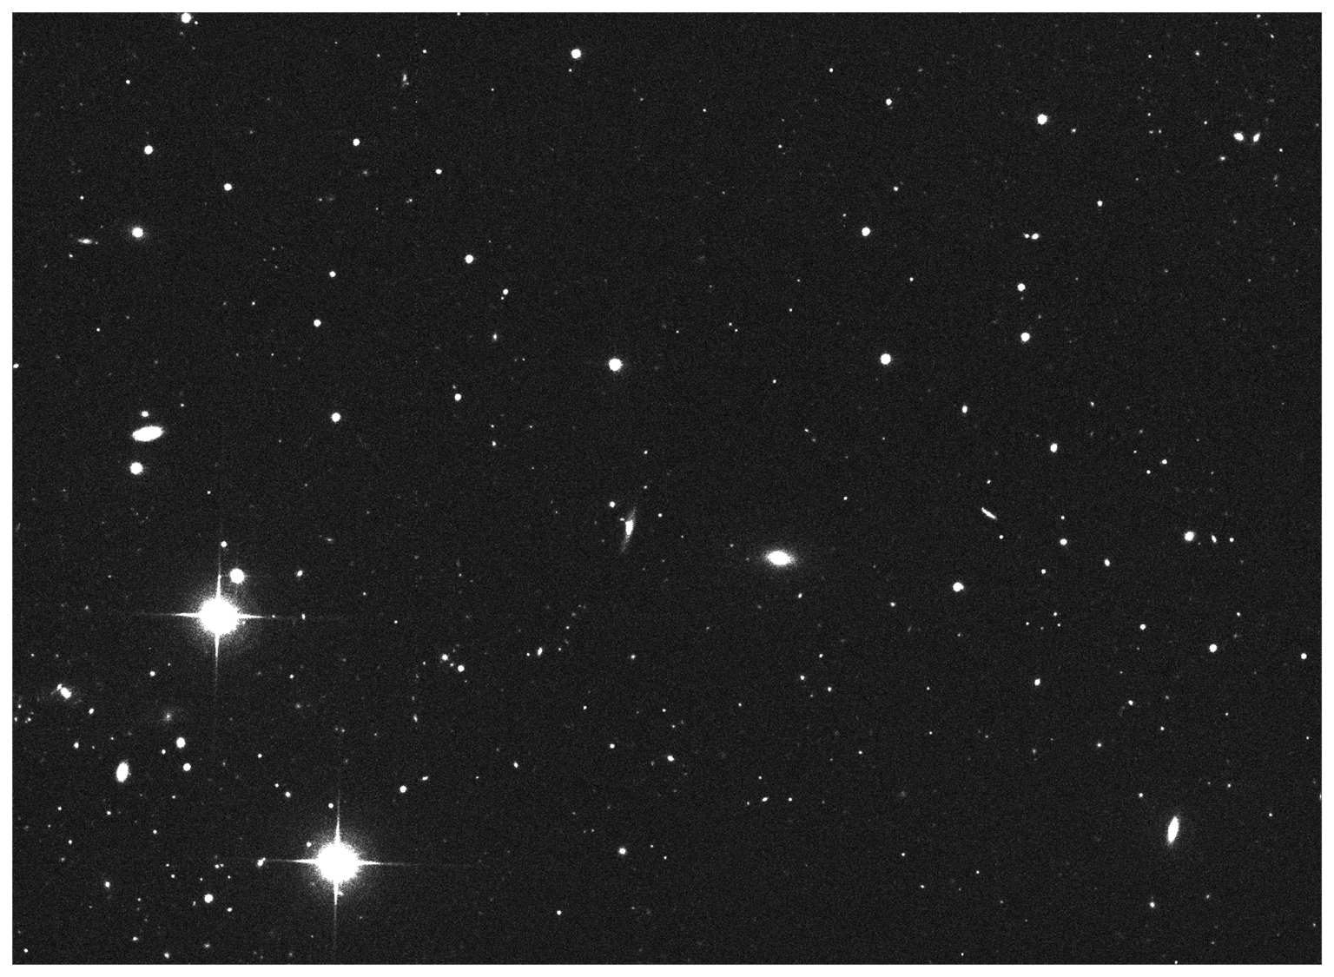
Datasets – Images
Notes:
Handy SDSS API
Processed Image from SDSS
Normalized
Scaled
Background Subtracted
Noise Reduced
Cant train model on entire image → Associate record in data set with object in image

Slide 8
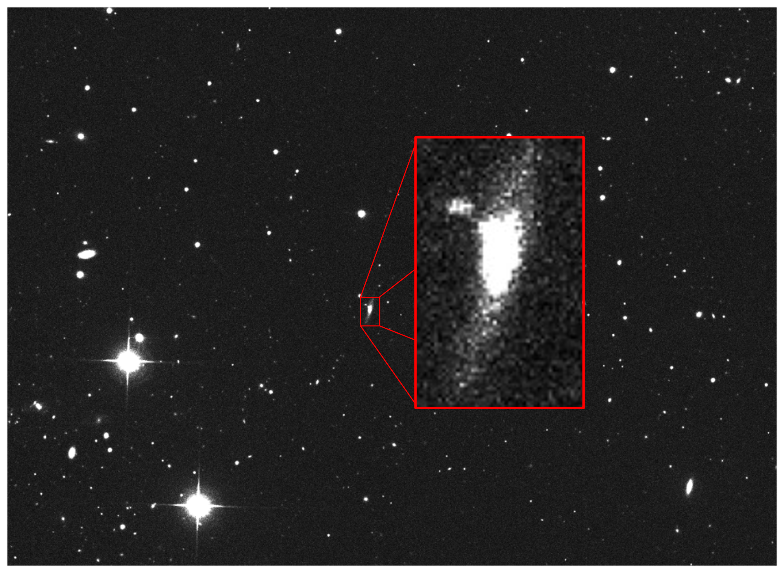
Datasets – Images
Notes:
Essentially
Download image containing object → find source containing object → create an image “chip” of just the source
Do again for all 5 wavebands (ugriz)
Haven’t done this for every object
(that’s a lot of time and data)

Slide 9

Datasets – Images
0
1
0
1
Notes:
Essentially
Download image containing object → find source containing object → create an image “chip” of just the source
Do again for all 5 wavebands (ugriz)
Haven’t done this for every object
(that’s a lot of time and data)

Slide 10
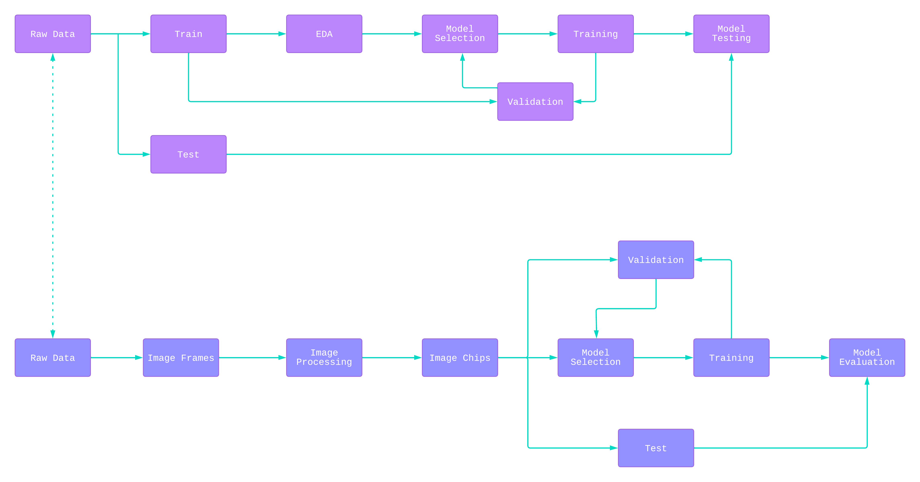
Block Diagram
Notes:
2 Stage problem
Top – Traditional Machine learning on the Photometry data – tabular
Bottom – Deep Learning on Image Data – Images
Wont go too indepth
Image processing at the front
Usual model selection → training → validation → iteration
Then to model evaluation on test set.

Slide 11
Methodology
Photometric Classification
Logistic Regression
Decision Tree
Gradient Boosting
Random Forest
Support Vector Machine
K-Nearest Neighbors
Voting Classifier
Image Classification
Fully Connected NN
Fully Connected NN + HyberBand tuning
Convolutional NN
Convolutional NN + HyberBand Tuning
Notes:
Split problem into two solutions
Photometric Classification
Tabular data on 100,000 objects
Using a voting classifier at the end
Closely connected
Image Classification
Training on images chips associated with the photometry data.
4 models

Slide 12
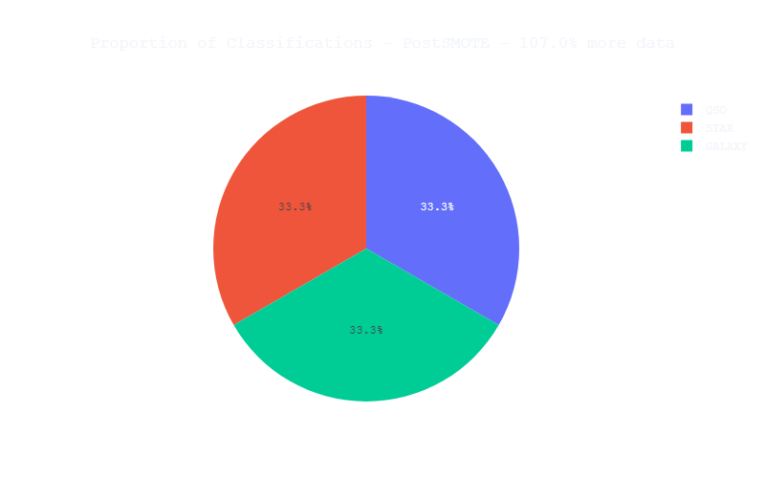
Baseline (Success or Failure)
Notes:
Baseline →Accuracy above 33%, since guessing “GALAXY” for every object gives 33%

Slide 13
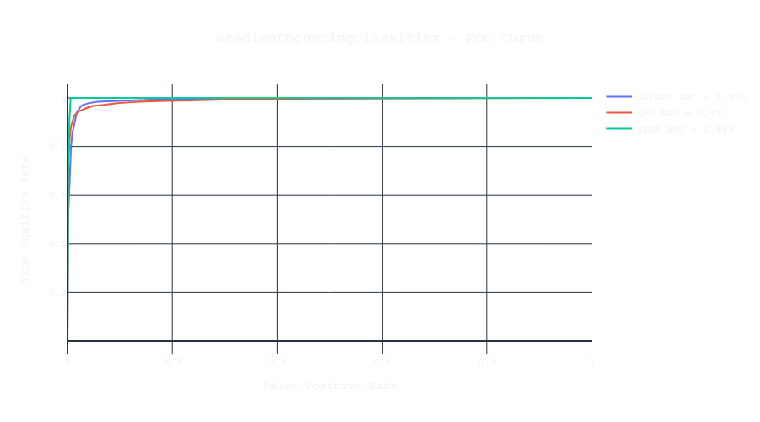
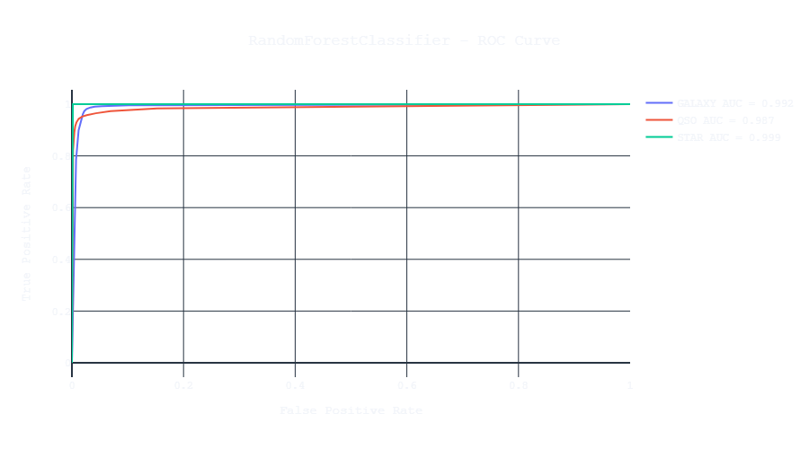
Evaluation – Photometry
Notes:
ROC Curves for traditional Machine Learning solution
GradientBoosting + RandomForest
Both in the upper 90s, indicating great performance!

Slide 14
Experiments – Photometry
Model | Hyper-parameters
LogisticRegression | multi_class = "multinomial"
DecisionTreeClassifier | Defaults
GradientBoostingClassifier | max depth = 10 n_estimators = 10 criterion = "squared error" min_samples_leaf = 1000
RandomForestClassifier | n_trees = 10
SVC | Defaults
KNeighborsClassifier | n_neighbors = 5
VotingClassifier | RandomForest GradientBoosting
Notes:
Hyper parameters used
Anything not listed is default value
VotingClassifier = RF+GB based on validation accuracy

Slide 15
Experiments – Photometry
Model | Accuracy | Recall | Precision | FN Rate | F1 Score | ROC AUC OVR | ROC AUC OVO
LogisticRegression | 0.953 | 0.953 | 0.954 | 0.047 | 0.953 | 0.989 | 0.991
DecisionTreeClassifier | 0.96 | 0.96 | 0.962 | 0.04 | 0.961 | 0.97 | 0.971
GradientBoostingClassifier | 0.968 | 0.968 | 0.969 | 0.032 | 0.968 | 0.994 | 0.995
RandomForestClassifier | 0.978 | 0.978 | 0.978 | 0.022 | 0.978 | 0.993 | 0.993
SVC | 0.969 | 0.969 | 0.97 | 0.031 | 0.969 | 0.993 | 0.994
KNeighborsClassifier | 0.961 | 0.961 | 0.962 | 0.039 | 0.961 | 0.985 | 0.986
VotingClassifier | 0.975 | 0.975 | 0.975 | 0.025 | 0.975 | 0.996 | 0.996
Notes:
Evaluation metrics for Photometry Classification
GradientBoosting + RandomForest (potentially SVC as well)
Highest accuracies
Highest ROC AUC OVO/OVR
VotingClassifier uses RandomForest+GradientBoosting

Slide 16
Experiments – Image Classification
Model | Trainable Parameters | Epochs
Fully Connected NN | 1,327,619 | 5
Fully Connected NN - HyperModel | 9,981,443 | 3
Convolutional NN | 16,836,611 | 5
Convolutional NN – HyperModel | 501,075 | 6
Notes:
Overview of the NN used for classification
I picked 5 epochs
Hypermodel picked 3 and 6
Conv HM has low # of parameters → extra epoch?

Slide 17
Results - Accuracies
Model | Training | Validation | Testing
VotingClassifier | 0.969 | 0.969 | 0.97
Fully Connected NN | 0.787 | 0.815 | 0.805
Fully Connected NN - HyperModel | 0.541 | 0.791 | 0.784
Convolutional NN | 0.822 | 0.808 | 0.797
Convolutional NN - HyperModel | 0.808 | 0.814 | 0.816
Notes:
High level model performances
Machine Learning voting classifier is best.
Higher quality data?
Deep Learning models didn’t perform as well.
highest is the Convolutional HyperModel w/ 0.816

Slide 18
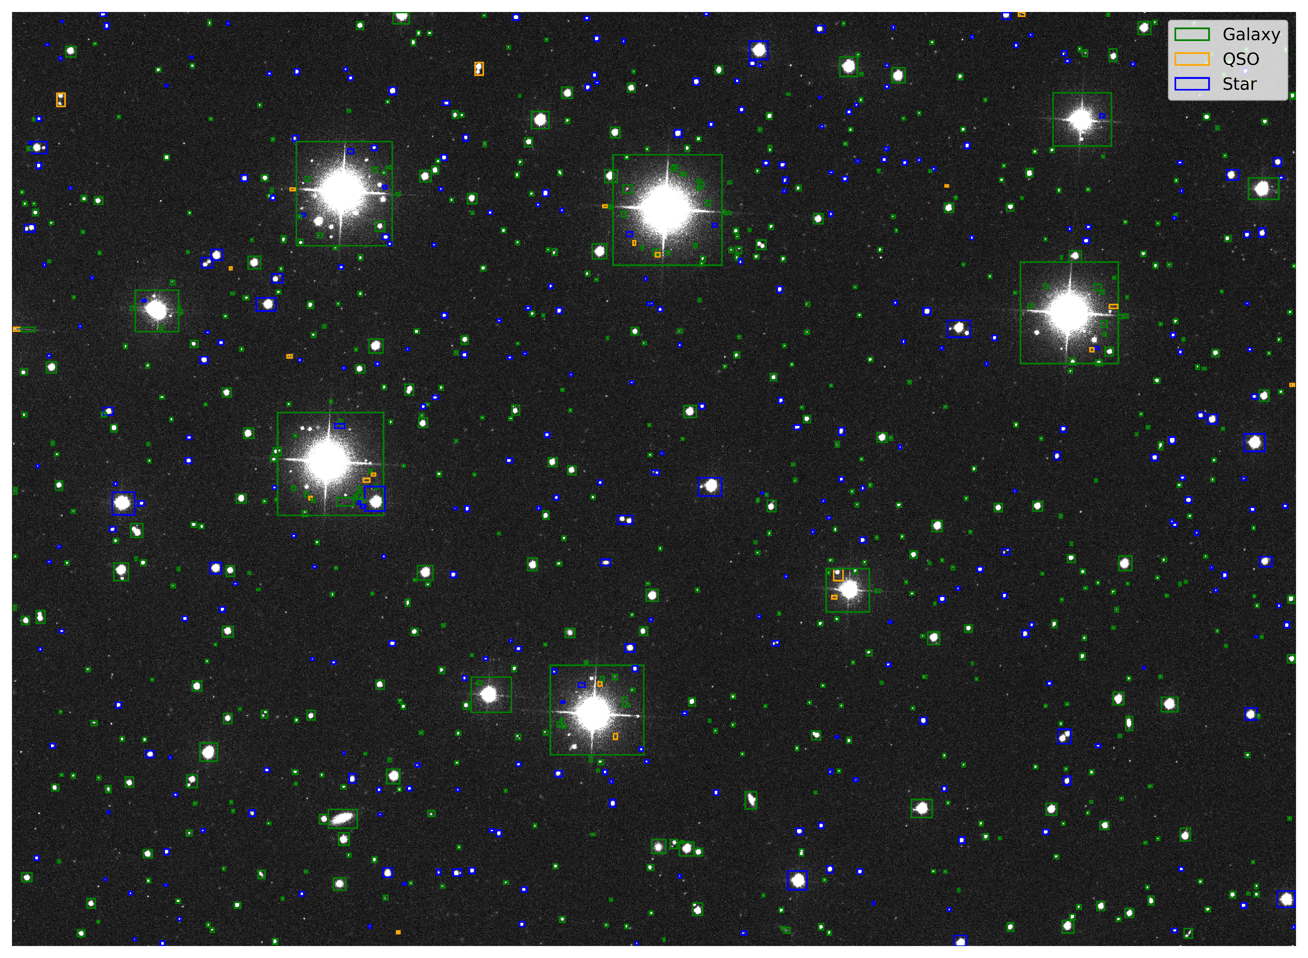
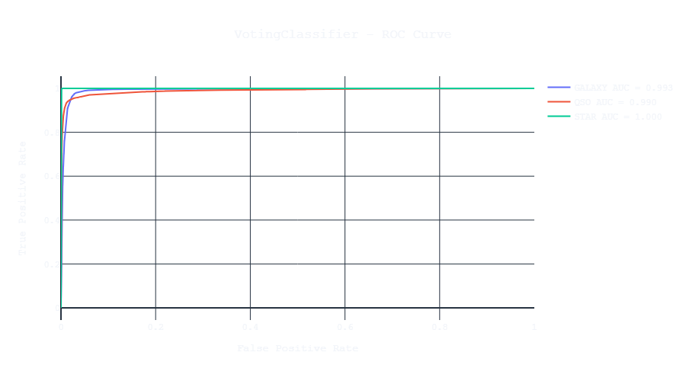
Discussion + Comparison
Notes:
Discuss the difference between two approaches
VotingClassifier
Tabular photometry data
Rows and columns
CNN-HyperModel
Image Chips with large variations

Slide 19


Limitations
Notes:
Create Images of a single object is hard!
Closely spaced objects make it hard to find object of interest
Improve accuracy
Proper segmentation
Proper deblending

Slide 20
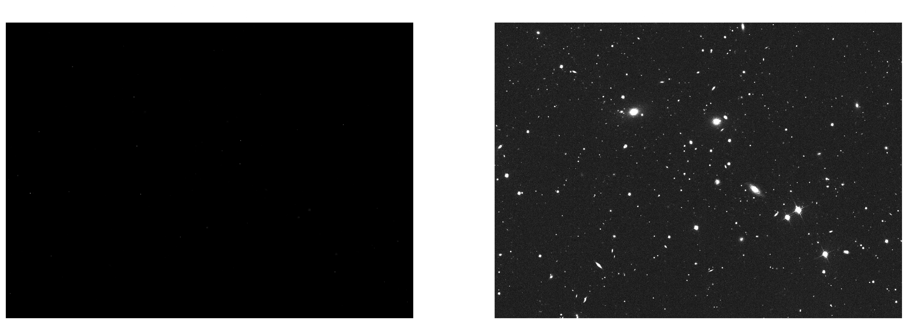
Limitations
Notes:
Left:
- raw image from SDSS
Right:
Normalized + background subtracted + noise reduced (all simple versions)

Slide 21

Constraints

Slide 22




Standards

Slide 23
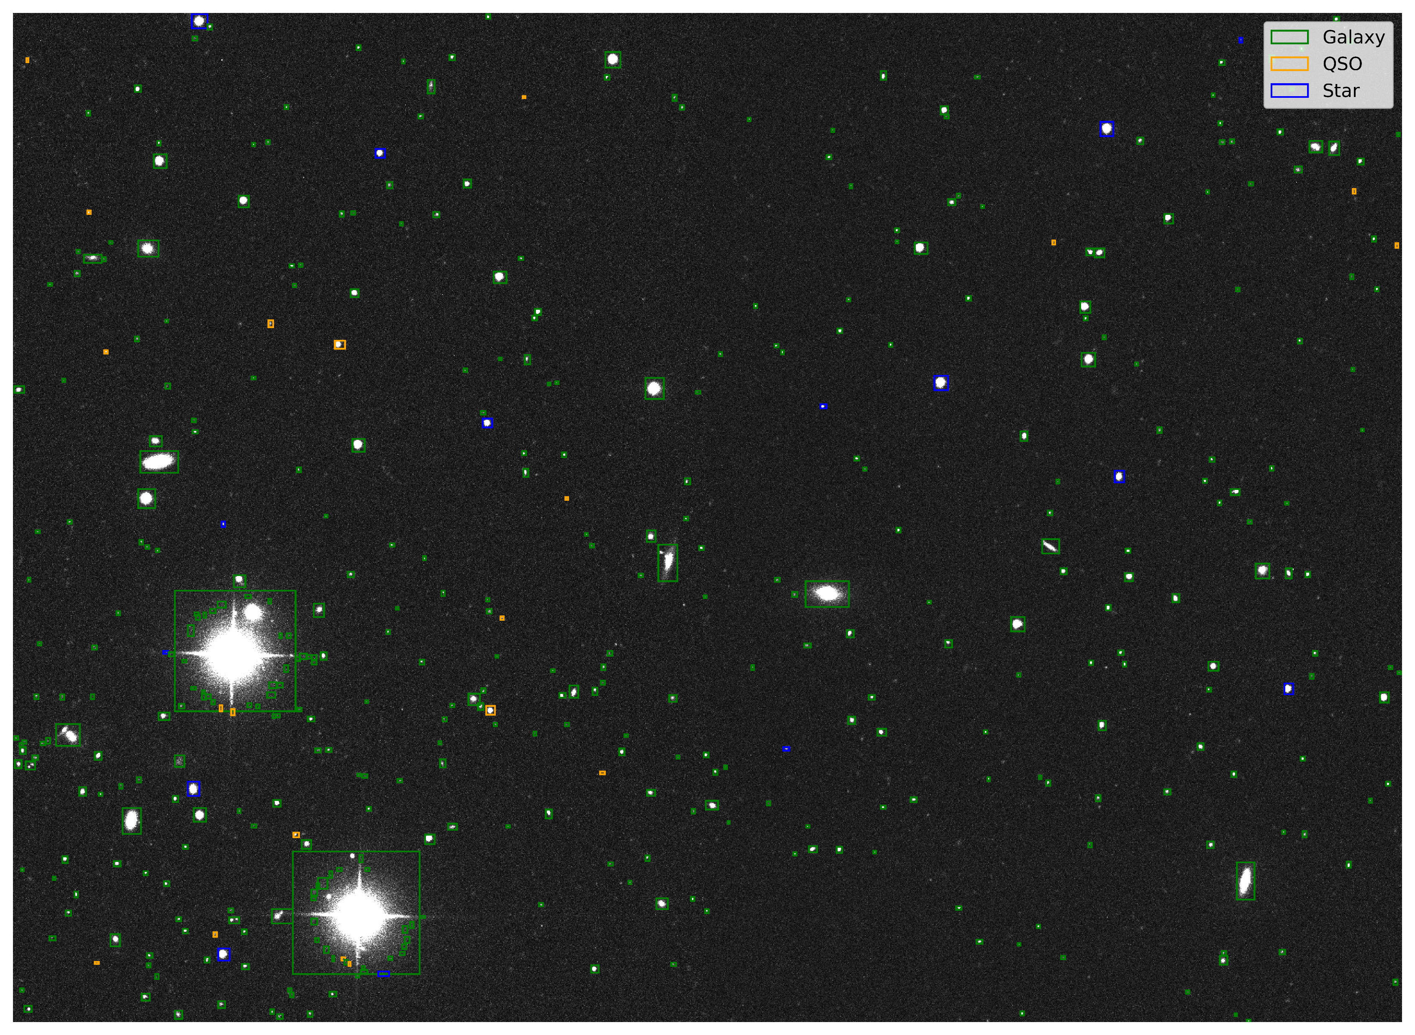
Future Work

Slide 24
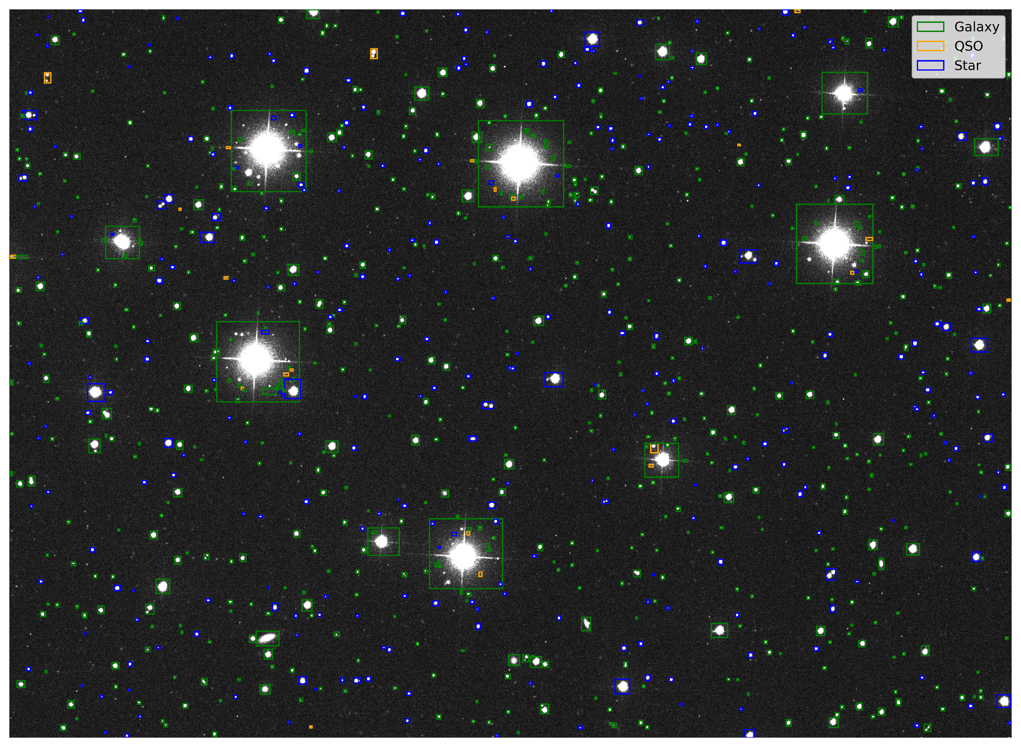
Future Work

Slide 25
Questions?

Slide 26
